Slide 1
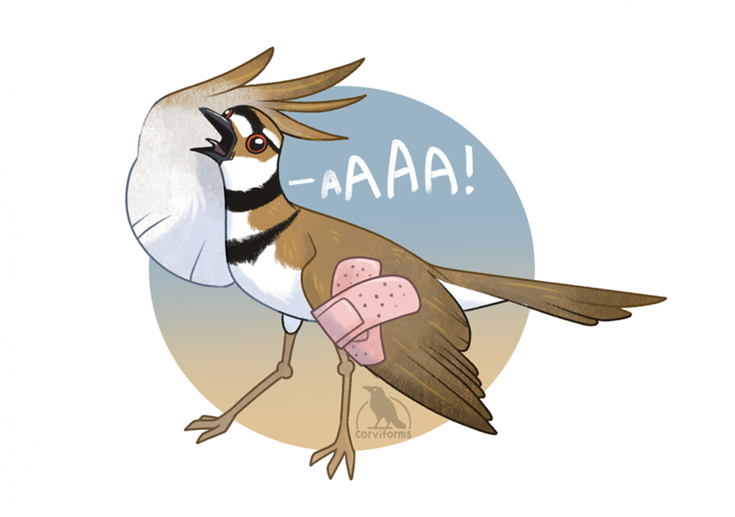
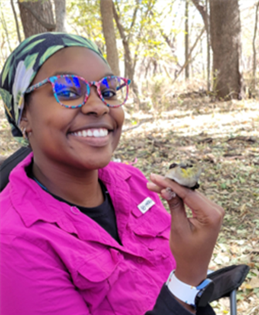
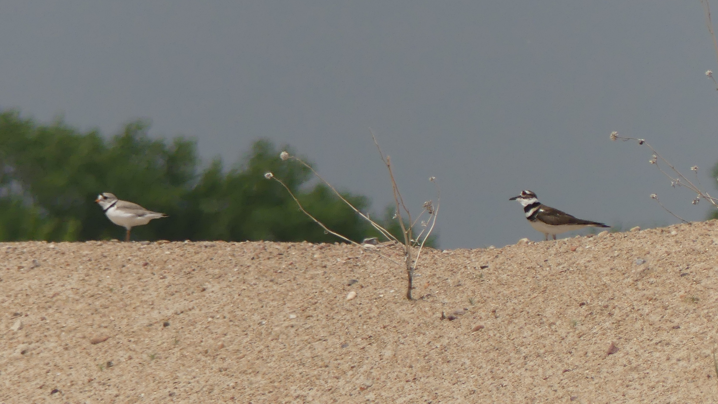
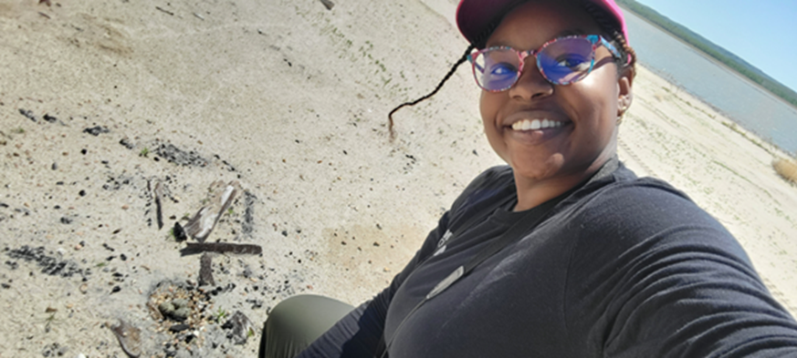

Parental care in Killdeer and Piping Plovers
Brandy Williams
School of Biological sciences, EEB
Shizuka Lab
Notes:
-Ground Nesting Shorebirds
-Rely on Camo
-Backup plan
KD=Loud Brown Bird
BWD (both birds)

Slide 2
Big Question: How does individual behavior give rise to community ecology?
What mechanisms are involved in the broken wing display?
Are these mechanisms responsible for individual variation in BWD?
Are Piping plovers benefiting from having Killdeer for neighbors?
Notes:
-Self preservation vs Parental care
-Cort and Prolactin; which one rules in BWD
-Does this mechanism explain individual variation
- Pip benefit from KD neighbors?

